Slide 1
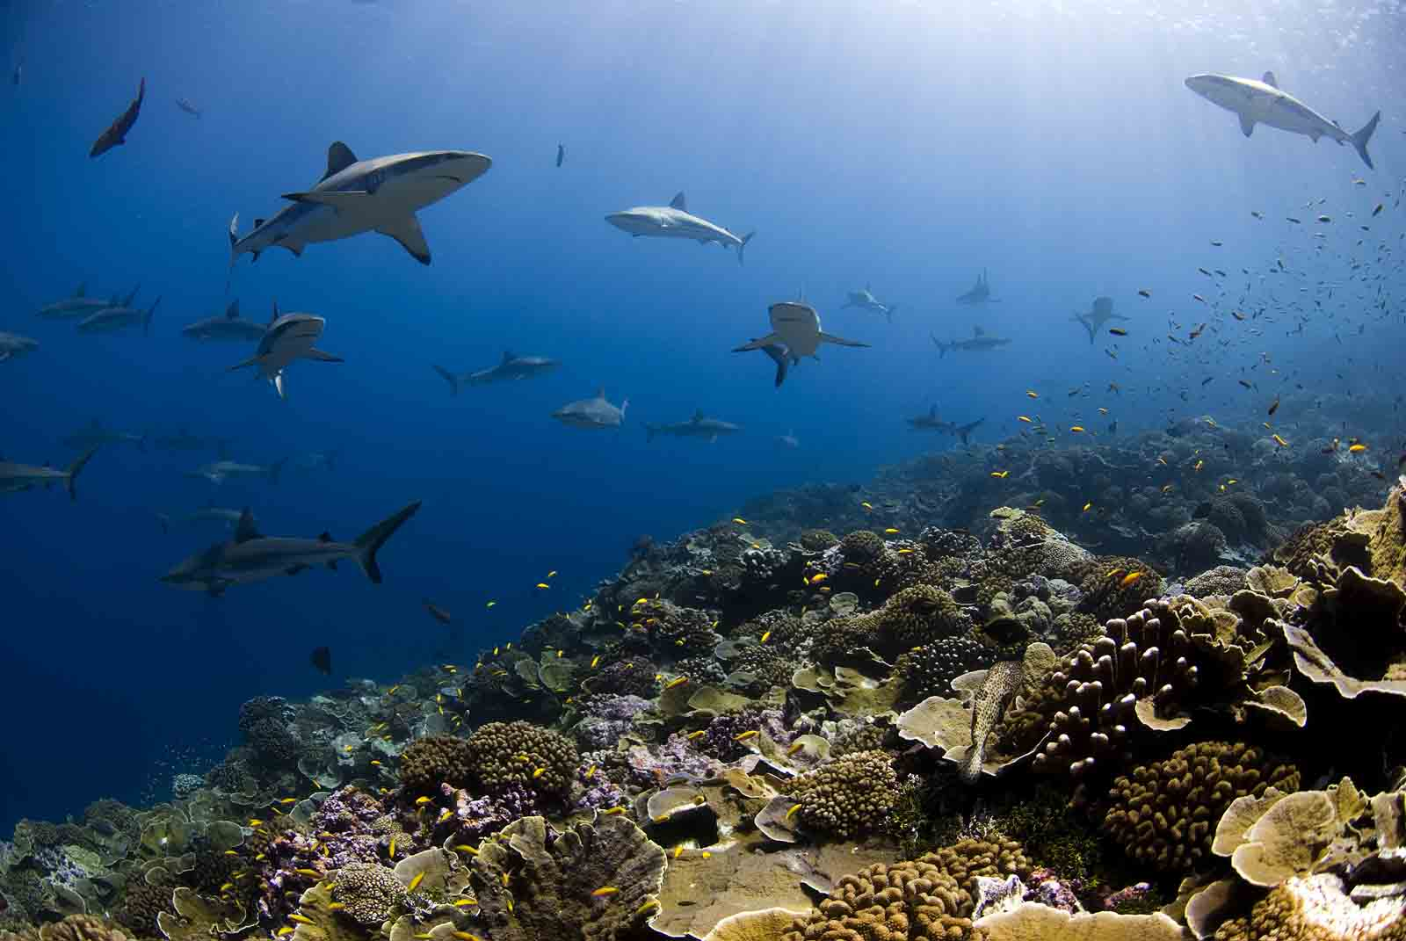
How top-down control by predatory fishes and humans influence reefs
A. Friedlander¹, E. DeMartini², E. Brown³, J. Beets⁴, J. Miller⁵
¹USGS-Hawaii Coop. Fish. Res. Unit, Univ. Hawaii
²NOAA-PIFSC
³National Park Service-Kalaupapa NHP
⁴Univ. Hawaii Hilo
⁵National Park Service-Virgin Islands National Park
Photo: E Sala

Slide 2
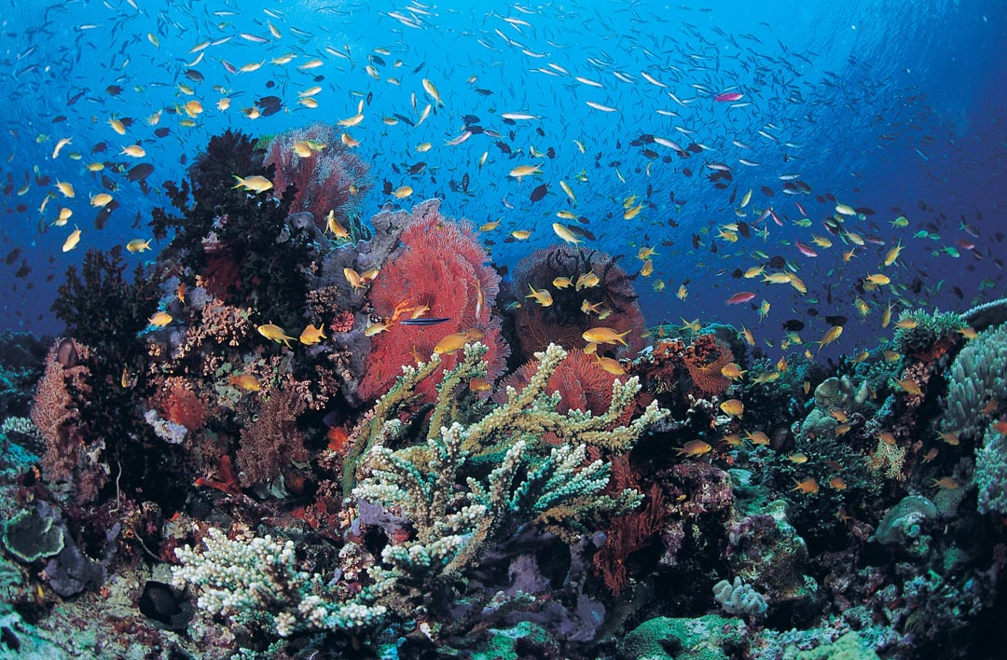
Outline
Coral reef ecosystem trophic structure
Effects of fishing: direct and indirect
Top-down control
Consequences of predator removal
MPAs
Notes:
SUMMARIZE RECENT NWHI findings for context – HOW GENERALIZABLE are NWHI PATTERNs (eg, of FISH TROPHIC STRUCTURE)? …

Slide 3
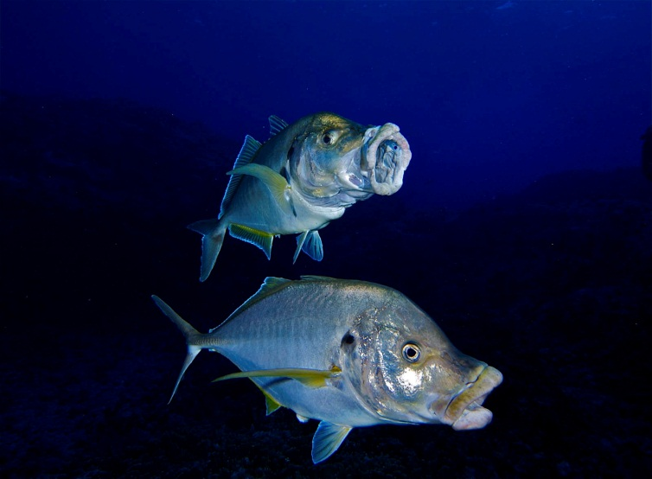
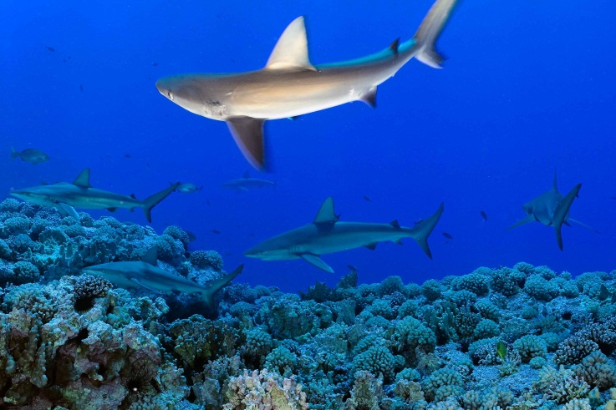
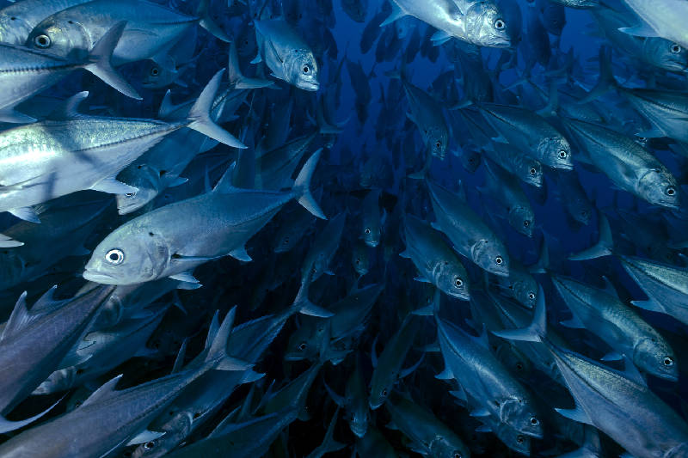
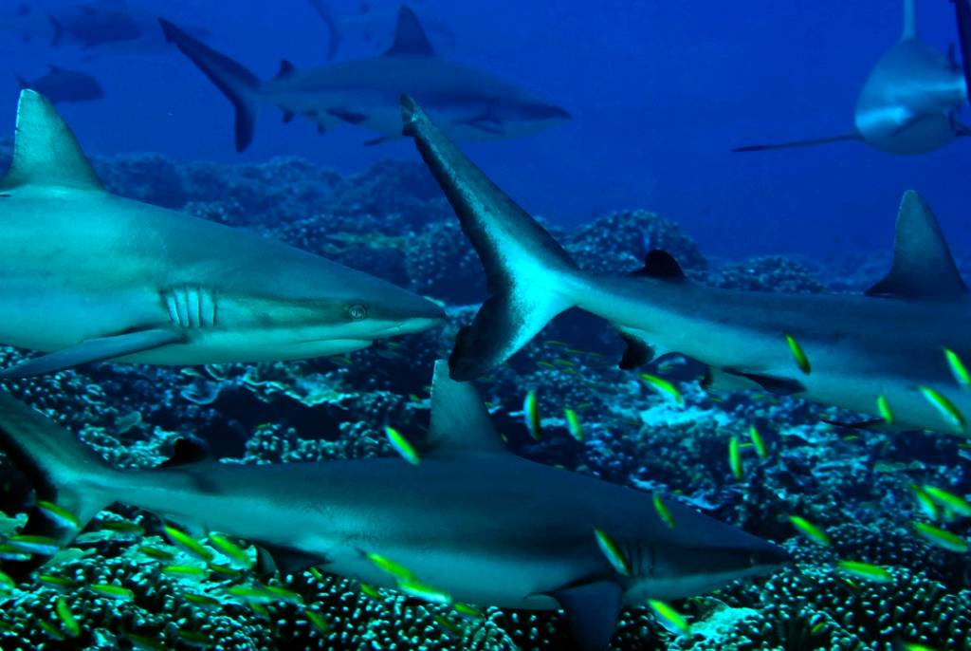
Photos: E. Sala

Slide 4
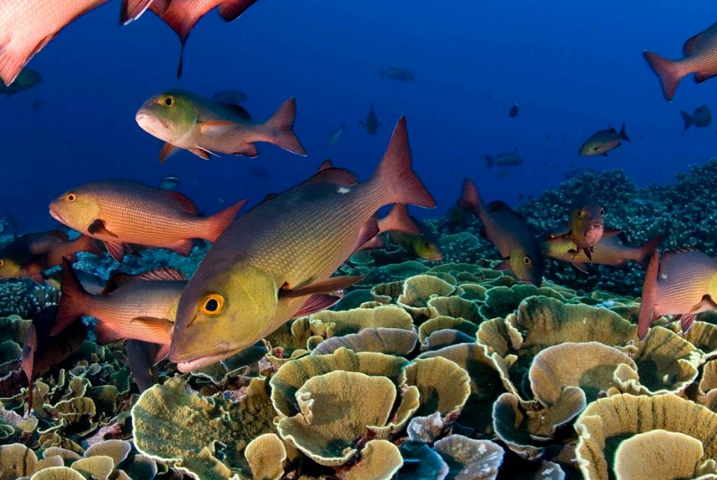
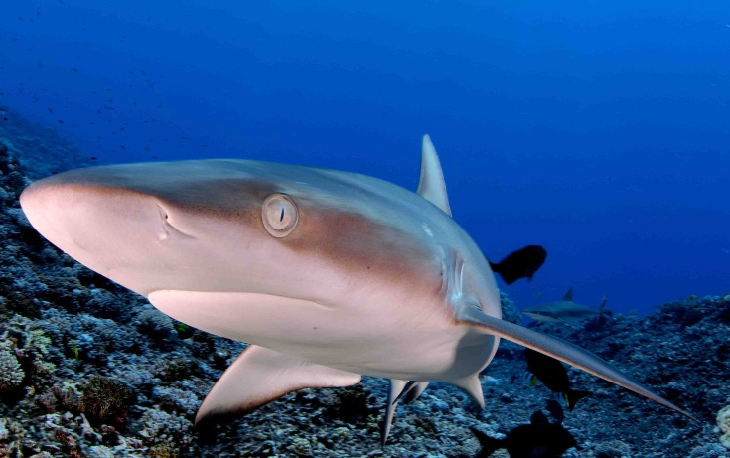
Apex predator life histories
Grey Reef Shark
Carcharhinus amblyrhynchos
Twin-spot red snapper
Lutjanus bohar
  slow growth:
  VBGF k = 0.2
  Low mortality M = 2k = 0.4 or S = 67% per yr
  late maturity: 4 yrs, 40 cm
  long-lived: > 30 yrs
Very slow growing
  VBGF k = 0.1
Long-lived to > 20 yr
Very late-maturing (age 7)
Low fecundity
  5 pups per yr
Notes:
Let’s look at the LIFE-HISTORY ATTRIBUTES of TWIN-SPOT RED SNAPPER as a PISCIVORE EXAMPLE. …
GROWTH, MORTALITY/LONGEVITY, and MATURATION ALL FOLLOW “SLOW-LOW” EXPECTATIONs for this Type of fish. …
And remember that red snapper comprise @ 1/4th of PISCIVORE BIOMASS, with SHARKs (PRIMARILY GREY REEFs) REPRSENTING @ 2/3rds of the PISCIVORE TOTAL. …
GREY REEF SHARKS GROW EVEN MORE SLOWLY, have a LOWER NATURAL MORTALITY RATE, LIVE 20 or MORE Yrs, and, unlike RED SNAPPER (which are oviparous and whose females spawn thousands of tiny eggs each year) are VIVIPAROUS – FEMALES PRODUCE ONLY an AVERAGE 5 PUPS ONCE a YEAR and DON’T MATURE TIL THEY are 7-Yrs-OLD. …
It’s no wonder that these fishes are highly vulnerable to fishing on ATOLL FOREREEFs where they are readily targeted. …

Slide 5
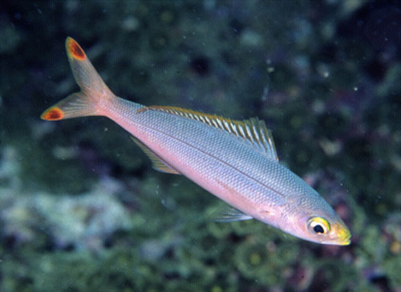
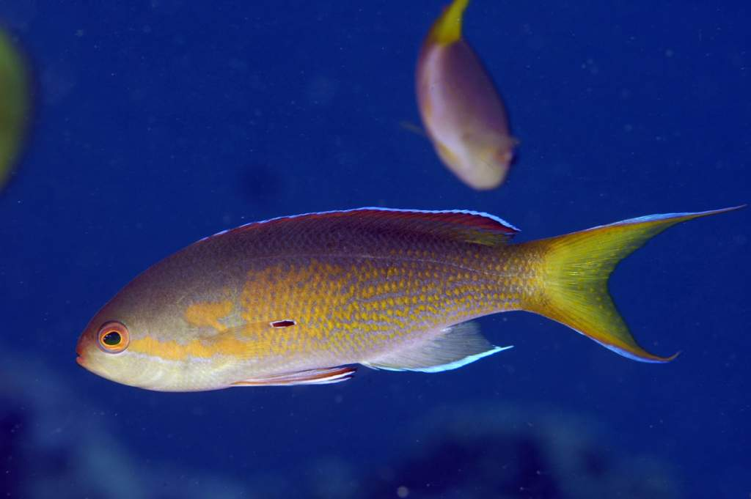
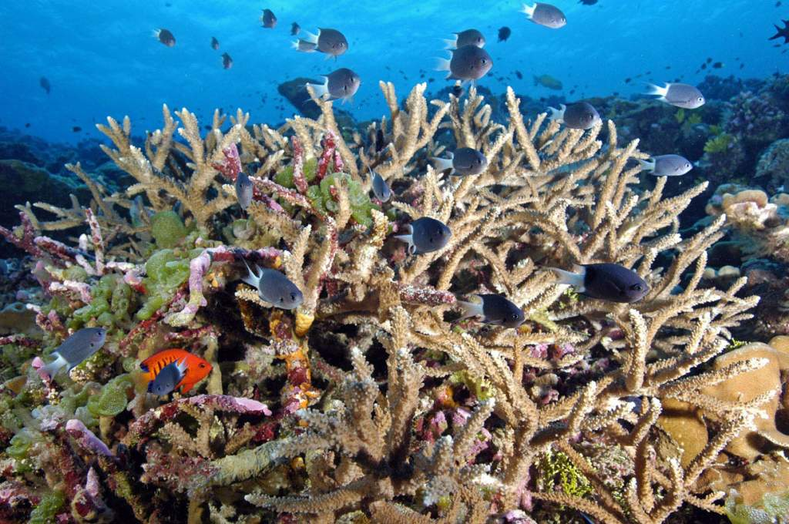
Prey life histories
eg, the banana fusilier Pterocaesio pisang
Rapid growth: VBGF k = 1.0
High mortality: M=2k = 2; equiv to A = 86% per yr (1-e^{-z})
Early maturity: < age 1
Short-lived: 1+ yr
High turnover: < 15-mo doubling time
Likely higher turnover in tiny planktivores like basslets (anthiines) & Chromis spp damselfishes, also gobies & blennies
Notes:
PLANKTIVOROUS PREY FISHES provide just the OPPOSITE PICTURE to that of APEX PISCIVORES. …
FUSILIERS (FAMILY CAESIONIDAE) are ILLUSTRATIVE:
HIGH TURNOVER RATE, with RAPID GROWTH, HIGH NATURAL MORTALITY; they MATURE EARLY and are SHORT-LIVED.
But even a high mortality rate of 2 in a 10- to -20 cm-long fusilier PALES RELATIVE to the LIKELY MORTALITY RATES of tiny reef fishes like BLENNIES and GOBIES, for which the FEW EMPIRICAL ESTIMATES that EXIST INDICATE INSTANTANEOUS NATURAL MORTALITY RATES (Ms) of 5 or 6 – EQUIVALENT to FINITE MORTALITY RATES of 99 to 99.9 % per year !!!

Slide 6
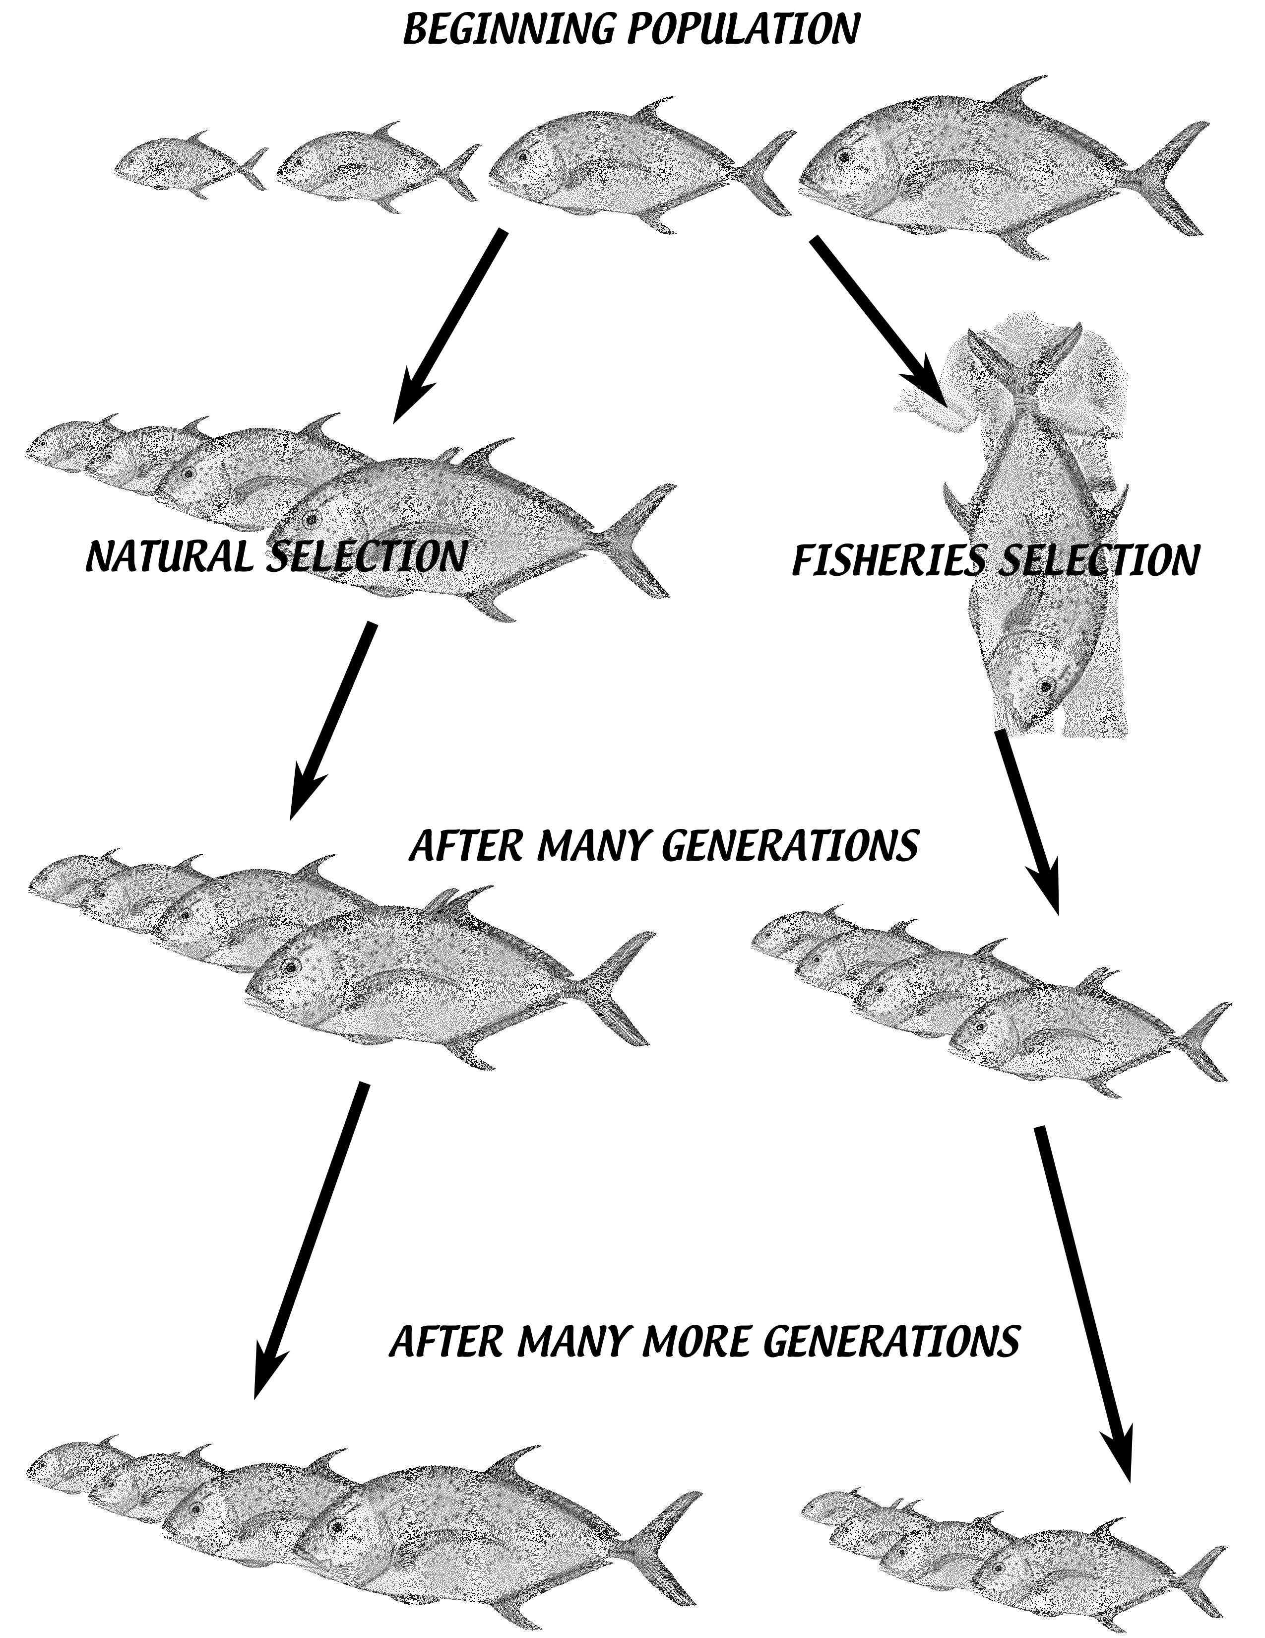
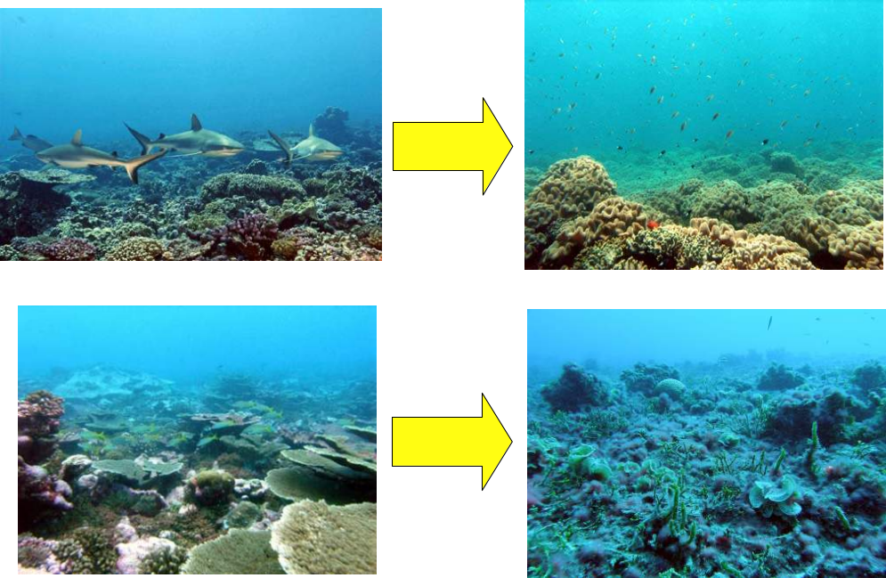
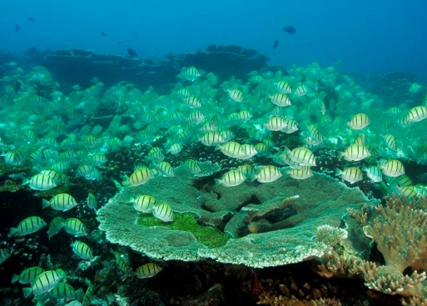
Direct Effects of fishing
Ecosystem Effects
Declines in:
  abundance
  size
  reproductive output
Changes in:
  sex ratio
  behavior & distribution
Changes in:
  Trophic structure
  Predator-prey dynamics
  Reduced herbivory
  Phase-shift

Slide 7
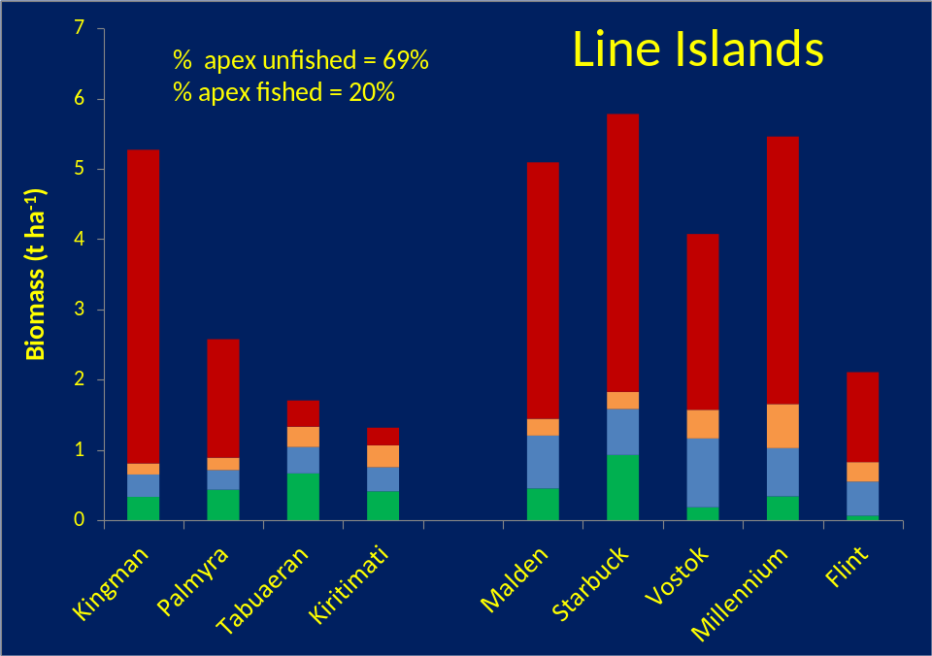
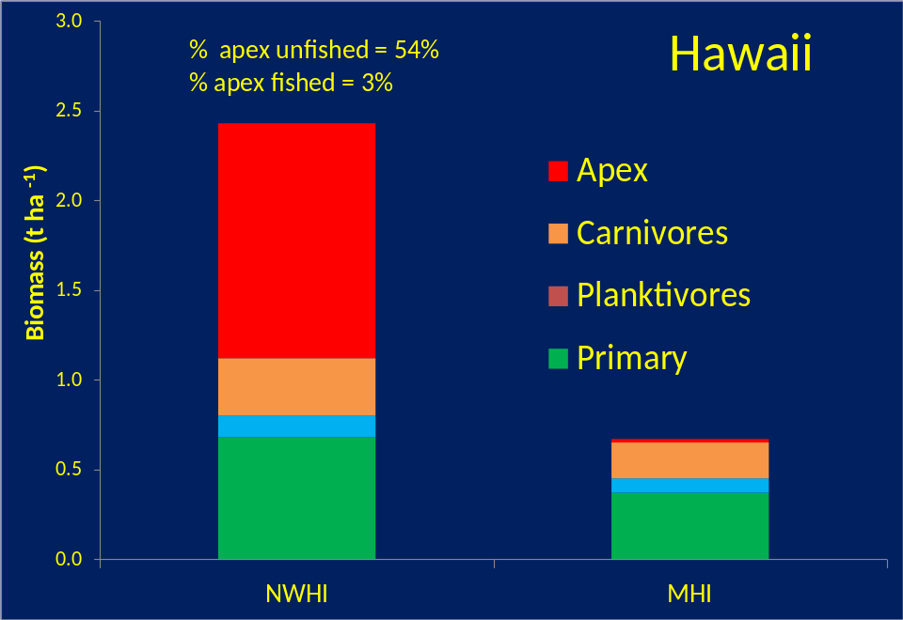

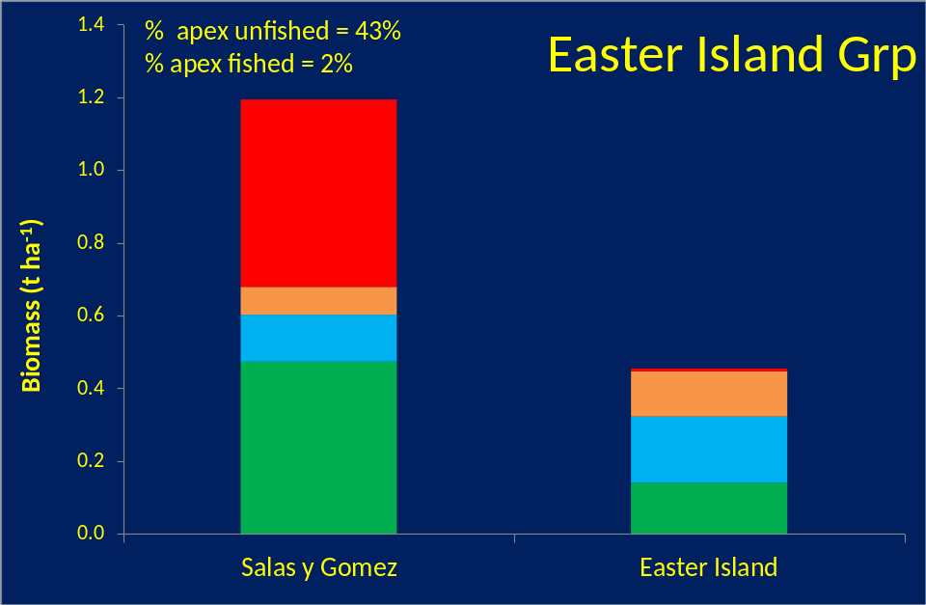
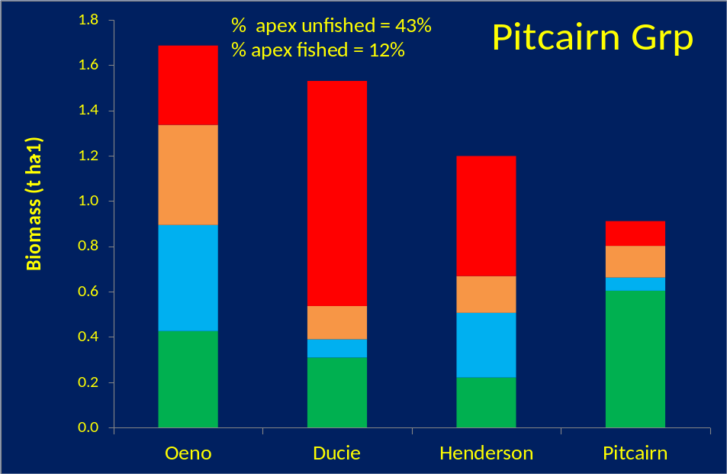

Trophic biomass comparisons w/in Pacific Island groups

Slide 8
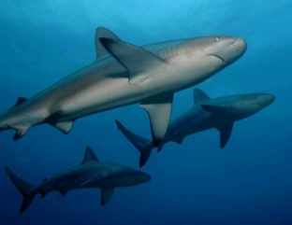
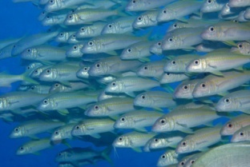
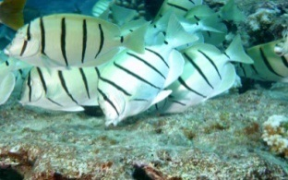
Production Pyramid vs.
Inverted Biomass Pyramid
Tertiary
10 units
Production pyramid
  Classical energy flow model
  Progressive (e.g., 90%) reduction in energy per trophic level
Inverted biomass pyramid
  Greater biomass of top-level consumers
  “Non-classical” predator-prey biomass ratios possible:
    “diffuse” predation
    High trophic efficiencies (to 20-30%) as poikilotherms
    disparate turnover (growth and mortality) rates of prey vs top predators
Secondary
100 units
Primary
(herbivores)
1000 units
Tertiary
500 units
Secondary
300 units
Primary
200 units
Notes:
NOW _HOW_ (you might ask) can all the PISCIVORE BIOMASS I have just described co-exist with lower-trophic level fishes on reefs like those in the NWHI and THESE UNFISHED ATOLLS in the Northern LINE ISLANDS ?!?
THIS and the FOLLOWING DIAGRAM QUALITATIVELY ILLUSTRATES WHAT WE BELIEVE IS OCCURRING. …
There are TWO, DISTINCTLY DIFFERENT ENTITIES – PRODUCTION and BIOMASS -- that one MUST KEEP SEPARATE. …
PRODUCTION, unlike BIOMASS, is DYNAMIC.
PRODUCTION represents a PROCESS – the RATE of BIOMASS CREATION and DESTRUCTION. …
BIOMASS, conversely, is STATIC – a simple measure of STANDING STOCK.
These TWO DIFFERENT METRICS _THUS_ have VERY DIFFERENT ATTRIBUTES.
The PRODUCTION PYRAMID (TOP FIGURE) schematically depicts the “CLASSICAL” TROPHIC PYRAMID with a conventional 10% TRANSFER EFFICIENCY. … TERTIARY CONSUMERs at the APEX of this PRODUCTION PYRAMID MUST be LOWEST in actual PRODUCTION.
The INVERTED BIOMASS PYRAMID (BOTTOM FIGURE) is QUALITATIVELY APPORTIONED to RESEMBLE a TYPICAL SITUATION on UNFISHED NWHI REEFs.
SEVERAL KEY FACTORS FACILITATE INVERSION of the BIOMASS PYRAMID, including …
“DIFFUSE” PREDATION (eg, PISCIVOREs CONSUME PRIMARY CONSUMER-HERBIVORES as WELL as SECONADRY CONSUMER-INVERTEBRATE-FEEDERs (and other, NON-FISH -- eg lobster, octopus -- PREY);
As cold-blooded organisms, reef and other fishes have TROPHIC EFFICIENCIES that RANGE MUCH HIGHER than those viewed as conventional for warm-blooded organisms; and
DISPARATE TURNOVER RATES of SMALL-BODIED PREY vs LRG-BODIED PISCIVORE FISHES
[If one further considers the ADDED EFFECT of a SUBSIDY by PLANKTONIC IMPORT of OFF-REEF PROCTION (LIKELY CONSIDERABLE on ATOLL FOREREEFs) , it is CLEAR that an INVERTED BIOMASS PYRAMID is NOT ONLY POSSIBLE BUT ALMOST ASSURED

Slide 9
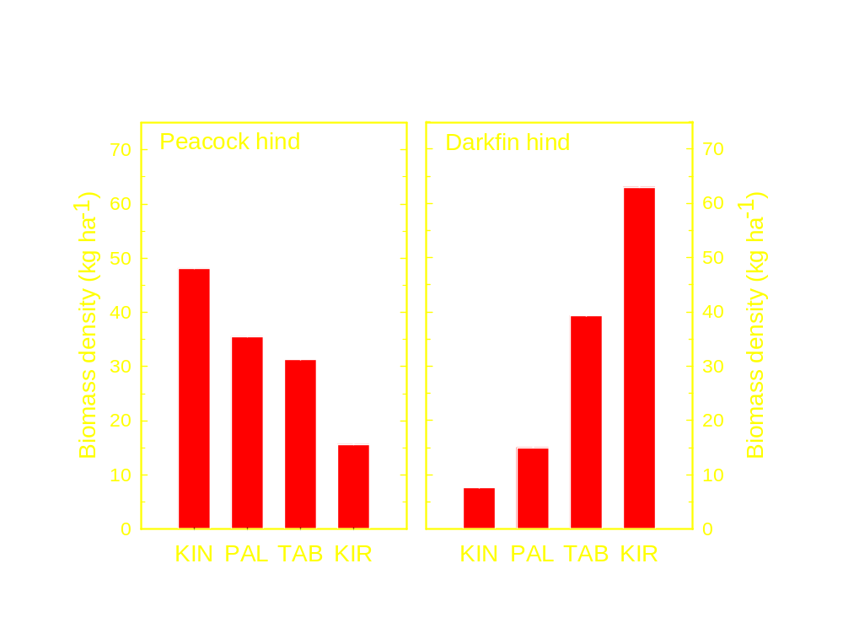
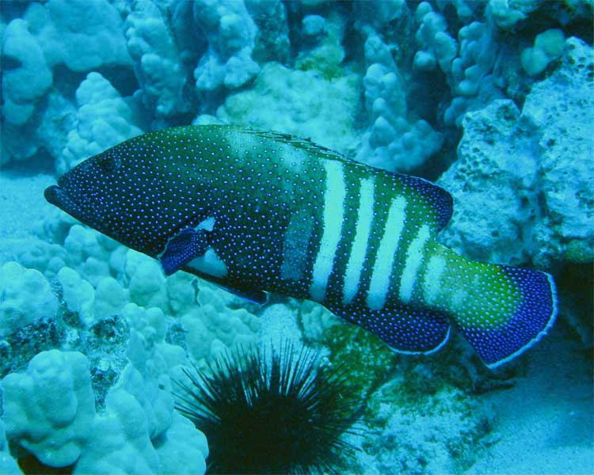
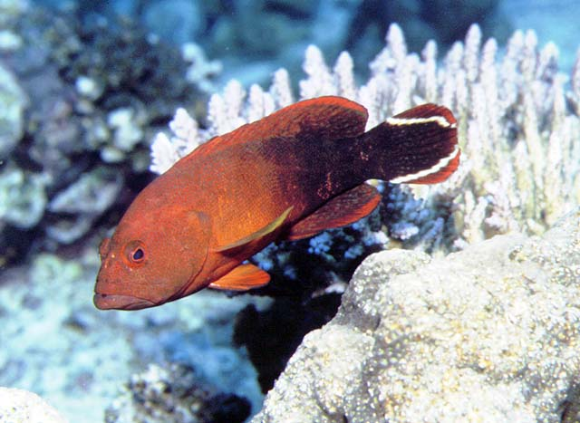
2 Grouper Species Differ in Harvest Pressure & Average Maximum Size - Competitive release of small predators
C. argus - 60 cm
C. urodeta
25-30 cm
Peacock hind: KIN = PAL = TAB > KIR
  1-way anova: F_{3,97} = 10.8, p < 0.0001
Darkfin hind: KIR = TAB > PAL = KIN
  1-way anova: F_{3,97} = 19.4, p < 0.0001
Notes:
The BIOMASS DENSITIES of THESE 2 SPP --- the TARGETED PEACOCK HIND and the NON-TARGETED DARKFIN HIND – SHOW EXACTLY the RESPONSE ONE MIGHT PREDICT ALONG the EXPLOITATION GRADIENT from TOTALLY UNFISHED KINGMAN to HEAVILY FISHED CHRISTMAS. …
It is TEMPTING to SPECULATE that DARKFIN HIND POPULATION at CHRISTMAS has EXPANDED in RESPONSE to COMPETITIVE RELEASE RESULTING from FISHING DOWN its LARGER-BODIED CONGENER. …

Slide 10
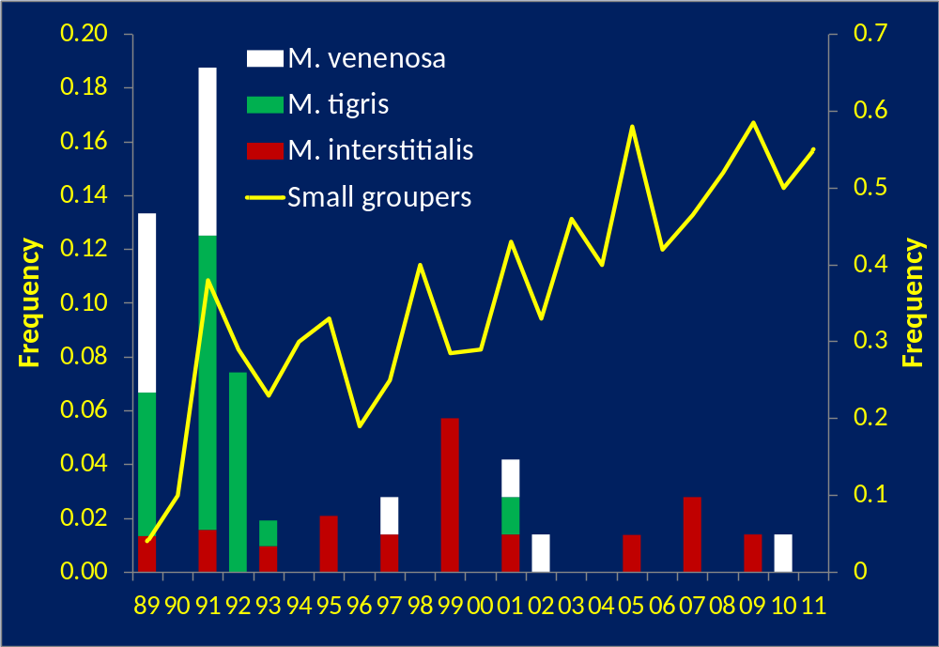
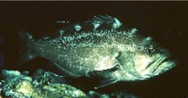
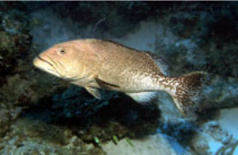
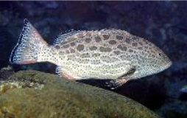
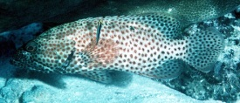
Loss of large groupers and rise of meso-carnivores around St John, Virgin Islands

Slide 11
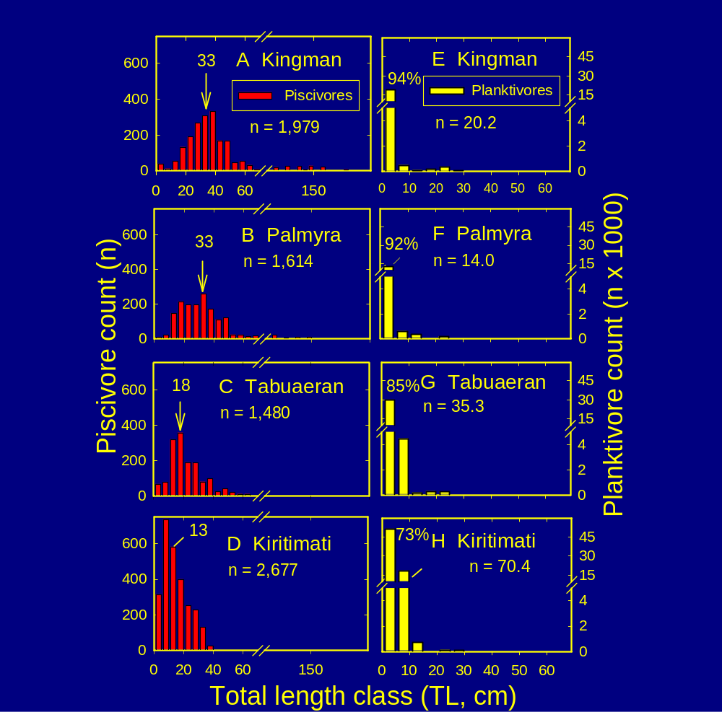
Piscivore-Prey TL Distributions
Piscivore lengths shifted left by extraction
  k-sample median test: p < 0.001
Planktivore prey < 10 cm
  more numerous at KIR release from piscivory
  larger at TAB-KIR - release from piscivory
  Median TL = 3 cm at all but more of smallest prey at KIN-PAL vs TAB-KIR
  median test: p < 0.001
DeMartini et al. 2010
Notes:
ADDITIONAL INSIGHTS into the EFFECTS OF FISHING are EVIDENT FROM the BODY LENGTH DISTNs of PISCIVOROUS PREDATORs and THEIR PLANKTIVOROUS PREY at the 4 ATOLLs. …
PERHAPS MOST STRIKING is the PROGRESSIVE SHIFT to SMALLER and SMALLER MEDIAN BODY SIZES of PISCIVORES ALONG the EXPLOITATION GRADIENT (from LEAST FISHED at KINGMAN-PALMYRA, to SOMEWHAT FISHED at FANNING, to HEAVILY FISHED at CHRISTMAS. …
LESS APPARENT BUT JUST AS FUNCTIONALLY IMPORTANT is the SHIFT to the LEFT in SIZE FREQUENCIES of PLANKTIVOREs ie, to DISPROPORTIONATELY MORE of the SMALLEST LENGTH CLASS (3-cm TL) – altho the median body lengths of planktivores is the same at all atolls) -- as well as NUMERIC RESPONSE (DECREASE in NUMBERS) of PREY FISHES at KINGMAN, where PLANKTIVOREs MUST BE the MOST HEAVILY CROPPED by PISCIVORES. …

Slide 12
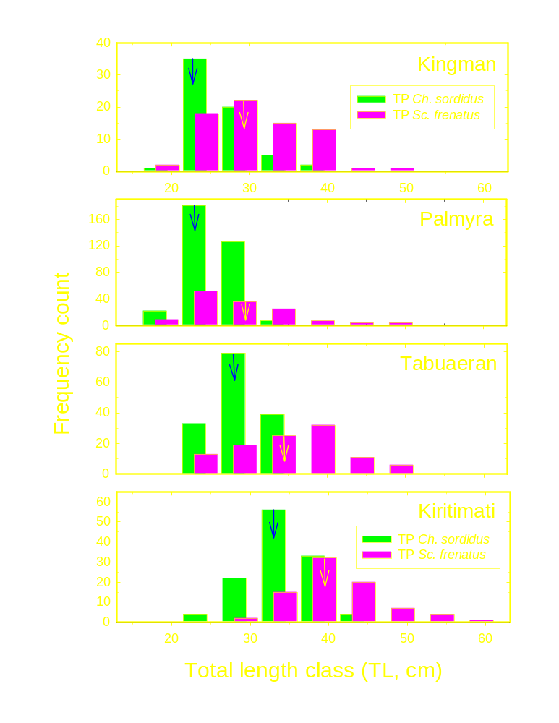
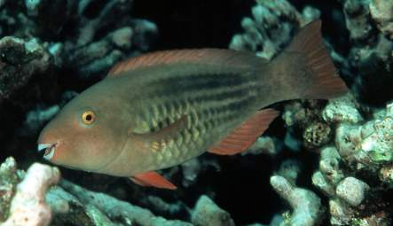
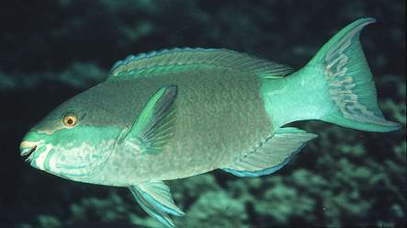
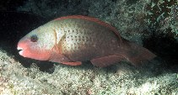
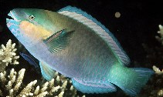
Associated life history changes with changing predation pressure
Bridled parrotfish, Scarus frenatus
Bullethead parrotfish, Chlorurus sordidus
Predator biomass
Median size sex change smallest at KIN-PAL & largest at TAB-KIR
k-sample median tests: p < 0.0001
S. frenatus = KIR > TAB > PAL = KIN
C. sordidus = KIR > TAB > PAL = KIN
DeMartini et al. 2010

Slide 13
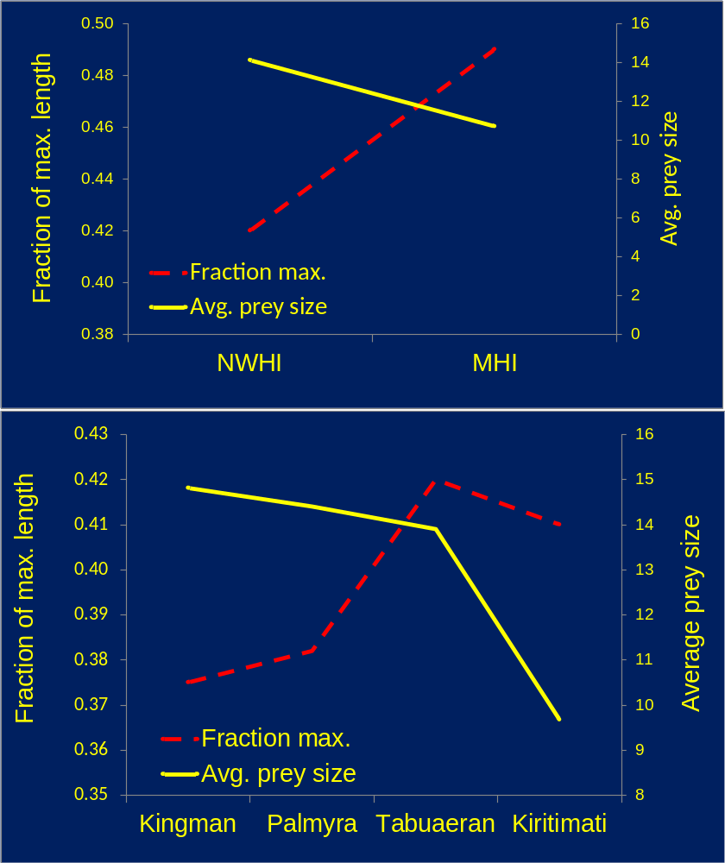
Fraction of max length w/in species & avg size of prey species
Average prey size smaller
in fished areas but max. size w/in species > owing to the lack of natural predation
Changes in body size likely
important for energetics of entire ecosystem through higher turn-over rates & greater ecosystem efficiency
Raffaelli & Friedlander 2012

Slide 14
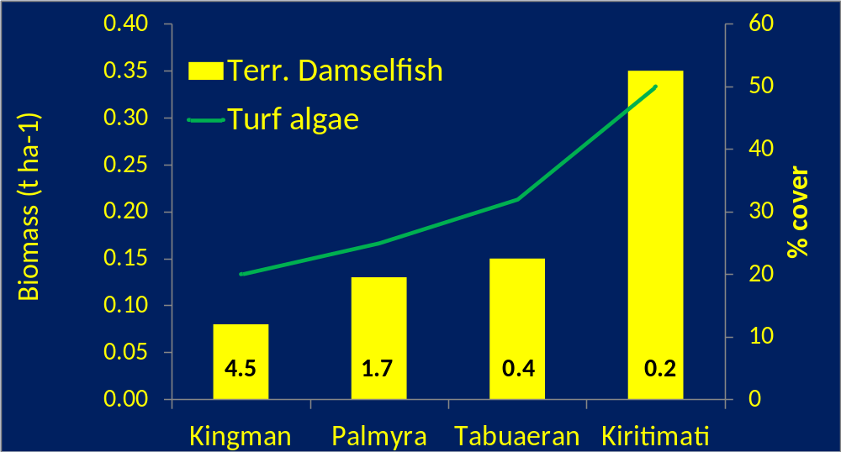
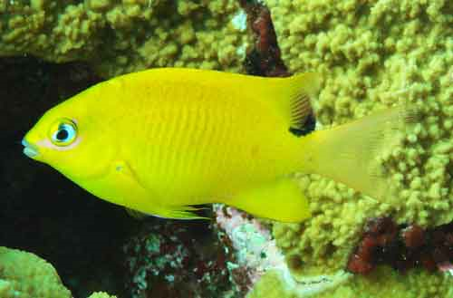
Territorial herbivore response to piscivory
Apex predator biomass
Territorial damselfishes more abundant in absence of predation
Terr. damselfish F_{3, 97} = 10.2 p<0.001 KIR ≥ PAL = TAB > KIN

Slide 15
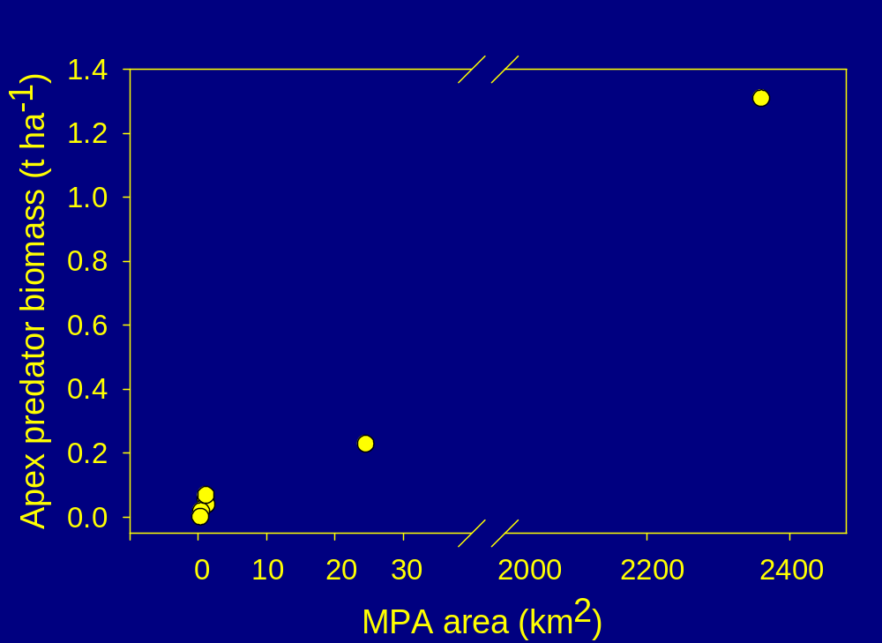
Apex predator biomass by MPA area in the Hawaiian Archipelago

Slide 16
Conclusions
Local human impacts, even at moderate levels, fundamentally change fish assemblage structure & function
  Loss of apex predators
  Changes in size structure
  maturation schedules (parrotfish size-at-sex change)
  Release of lower trophic levels
Fishing indirectly alters prey population dynamics by reducing top-down control of prey by predators
Without a baseline of how coral reefs used to look, we lack the capacity to adequately manage these resources in the future (“shifting baseline”).
Notes:
Or _BOTH_ LARVAL SUBSIDY _AND_ COMPENSATORY POST-SETTLEMENT SURVIVAL?

Slide 17
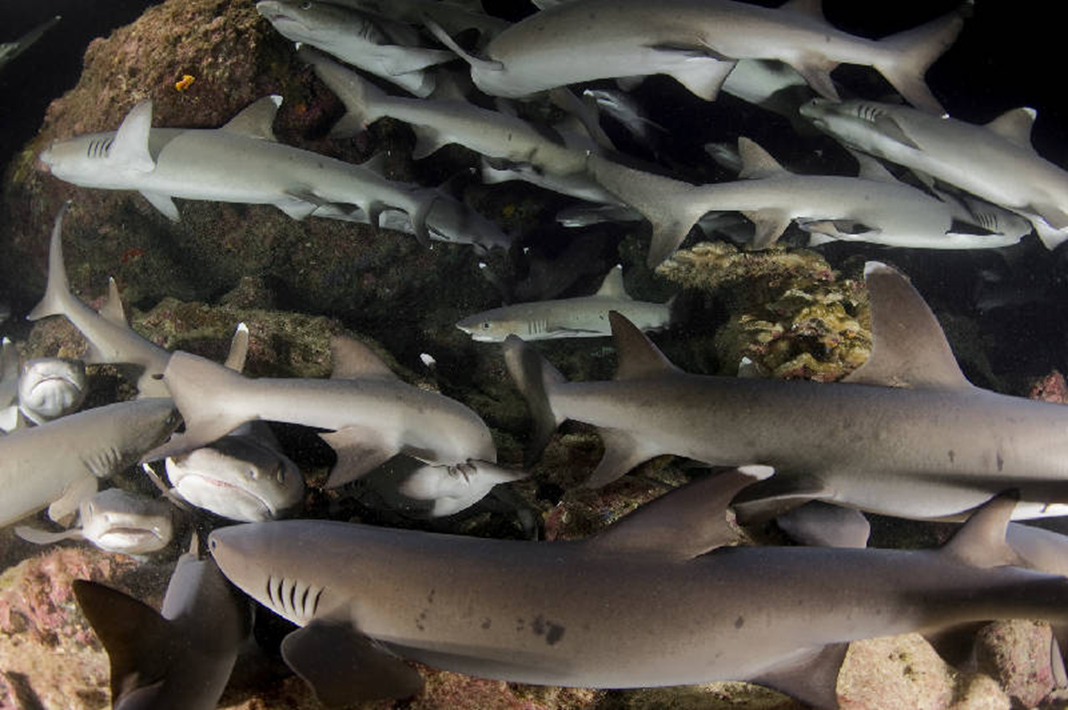
Thanx

